Slide 1
NYS Canal Embankment
Restoration Program

Slide 2
Vegetative Screening Plan Considerations:
Vegetative Screening Plans were developed for sites with residences adjacent based on :
Property Owner Preference
Effective Remaining Buffer to Residence
Height of the Embankment
Location of Residence on Property
Plant Species Type
Notes:
We have set out the following considerations for development of screening plans for affected adjacent residents
Property owners desire to have screening will be the primary driver for vegetative screening for those properties with residences on them
The second consideration is to determine if a buffer was left and how effective it is at screening. Effectiveness is the ability to allow screening for at least three seasons at a minimum.
The third considerations is the height of the embankment and the location of the residence on the property. These two factors will drive which of the two vegetative screening zone areas that could be available either at the toe or the top of slope
Lastly each of these screening zones will have a different plant palette that is able to be refined based on the individual site conditions and adjacent vegetation

Slide 3
Plant Species Criteria:
Native NYS Plants are preferred with adapted native acceptable
Root ball depths- 2’-3’ maximum (top of slope planting)
Ability to screen effectively in at least 3 seasons
Species availability at nurseries
Notes:
Plant selection will be critical for the success of the project. Top of slope plantings as noted previously will need to be limited to shrub material with a root ball depth of less than 2’- 3’ , to meet embankment vegetative management standards.
It is the teams desire to use only native or native adapted plant species for the vegetative screening. Use of these types of plant materials will compliment the existing material on the adjacent properties to provide some level of consistency and harmony.
By using these species, the Canals team desires to provide at screening in a minimum at least 3 seasons.
The last consideration of for species selection is availability as nurseries within a 150-200 mile radius. We don’t want to specify species which are not available within a regional climate since the climate in the western NY area is a bit atypical with higher wind patterns and greater snow depths than other areas of NYS.

Slide 4
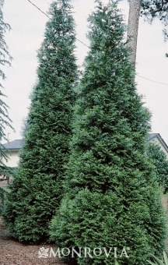
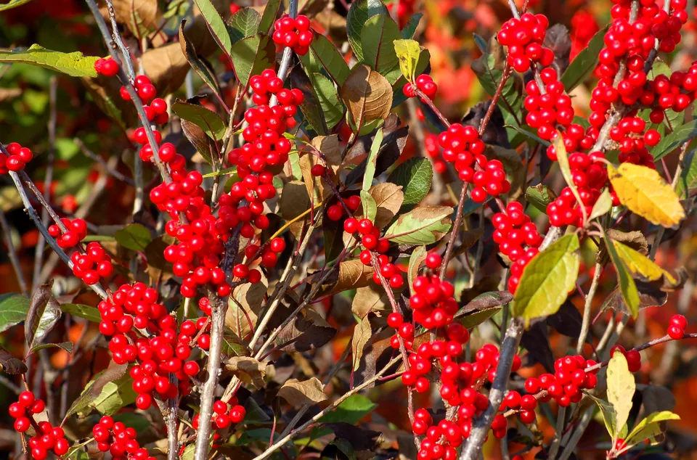
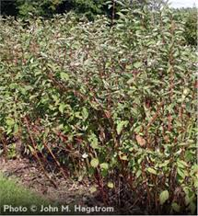
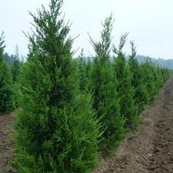
Plant Selections- Shrubs:
Initial example shrub species:
Winterberry
(8’-10’ mature height)
Arborvitae
(15’-20’ mature height)
Red Osier Dogwood
(6’-9’ mature height)
Robusta Green Juniper
(10-15’ mature height)

Slide 5
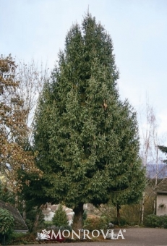
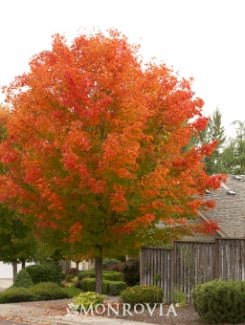
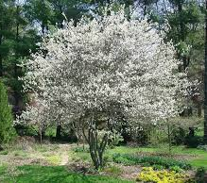
Plant Selection- Trees:
Initial example tree species*:
Red Maple
(35’-45’ mature height)
Norway Spruce
(50’-60’ mature height)
Serviceberry
(10’-15’ mature height)
*- Trees shall only be used on the potential toe of slope vegetative screens

Slide 6
Typical Bottom of Slope Screening Plan
Notes:
On this slide I will be describing the typical views and type of planting
This slide represents the preferred location for plantings based on the ability to provide impactful screening upon planting for adjacent resident provide a visual representation of what the different location of vegetative screening the following slides have been developed

Slide 7
Typical Vegetative Screening Plan
Typical Unscreened View of Embankment
Notes:
This rendering represents a created semi typical view from a rear yard of an adjacent resident looking up toward the embankment. I should note that embankment grass treatment within this image shows a typical grass cover and there will be opportunities to establish pollinator areas and other types of grassed cover treatments based on embankment height and slope .

Slide 8
Typical Vegetative Screening Plan
Rendering of Bottom of Embankment Vegetative Screening at Installation
Notes:
This rendering shows the view with the installation of vegetative screening at the toe of slope. The height of the vegetation is approximately 12’ for the deciduous trees, 8’ for the evergreen trees and 18”-24” for the shrub materials. As you can note a significant level of screening is available up planting. Based on the potential screening effectiveness for the adjacent residents upon installation, the toe of slope planting are the preferred locations for vegetative screening.

Slide 9
Typical Vegetative Screening Plan
Rendering of Bottom of Embankment Vegetative Screening at 3-5 years
Notes:
This rendering depicts the same screen planting in 3-5 years. As you can note the over story canopy is knitting together screening the canal trail effectively. In discussions with the arborist, an annual growth rate of 12-18 inches could be expected.

Slide 10
Typical Top of Slope Screening Plan
Notes:
On this slide I will be describing the typical views and type of planting
To provide a visual representation of what the different location of vegetative screening the following slides have been developed

Slide 11
Typical Vegetative Screening Plan
Typical Unscreened View of Embankment
Notes:
This rendering represents a created semi typical view from a rear yard of an adjacent resident looking up toward the embankment.

Slide 12
Typical Vegetative Screening Plan
Rendering of Top of Slope Vegetative Screening at Installation
Notes:
Existing view showing top of slope screening in about 3-5 years of growth

Slide 13
Typical Vegetative Screening Plan
Rendering of Top of Slope Vegetative Screening at 3-5 Years
Notes:
This rendering depicts the same screen planting in 3-5 years. As you can note the over story canopy is knitting together screening the canal trail effectively. In discussions with the arborist, an annual growth rate of 12-18 inches could be expected.

Slide 14
Project Links and Contact Information:
NYS Canal Corp. Website:
http://www.canals.ny.gov/
NYS Canal Corp. Embankment Restoration Website- http://www.canals.ny.gov/Embankment
NYS Canal Corp. Point of Contact:
Jackie Schillinger
New York State Canal Corporation
30 South Pearl Street, Albany, NY 12207
518-449-6026
embankment.restoration@canals.ny.gov

